Slide 1

Members vs Casuals
Presented by: Dinesh Venkat
Last Updated: December 15th, 2022

Slide 2
Table of Contents:
Objective
Data used for analysis
Data insights
Conclusions
Appendix
Recommendations

Slide 3
What are we talking about?

Slide 4
Objective:
To identify the difference in usage of bikes by annual membership users and casual users of the Cyclistic company.

Slide 5
Data used for Analysis:
Source: Monthly data downloaded directly from the company website.
Period covered: December 2021 - November 2022

Slide 6
Data Insights

Slide 7
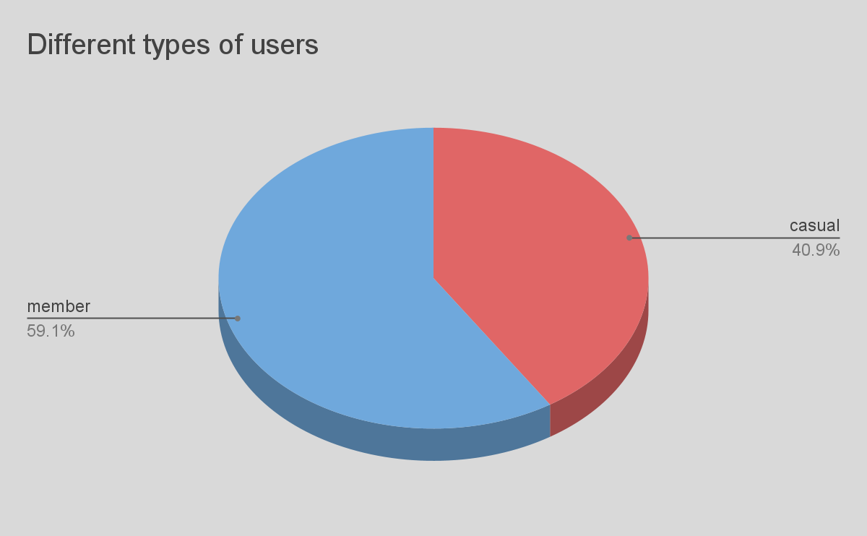
Usage frequency of different users
Collectively, Casual users use bikes less than membership users.

Slide 8
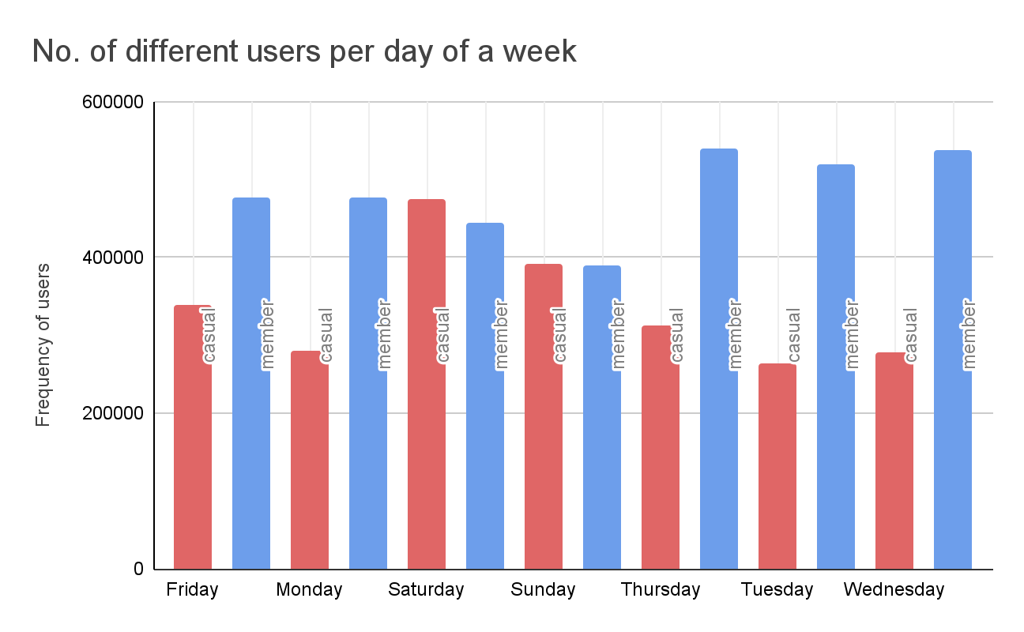
No of different users on weekly basis
Casual users use a little more than membership users on weekends whereas Membership users dominate bike usage on weekdays.

Slide 9
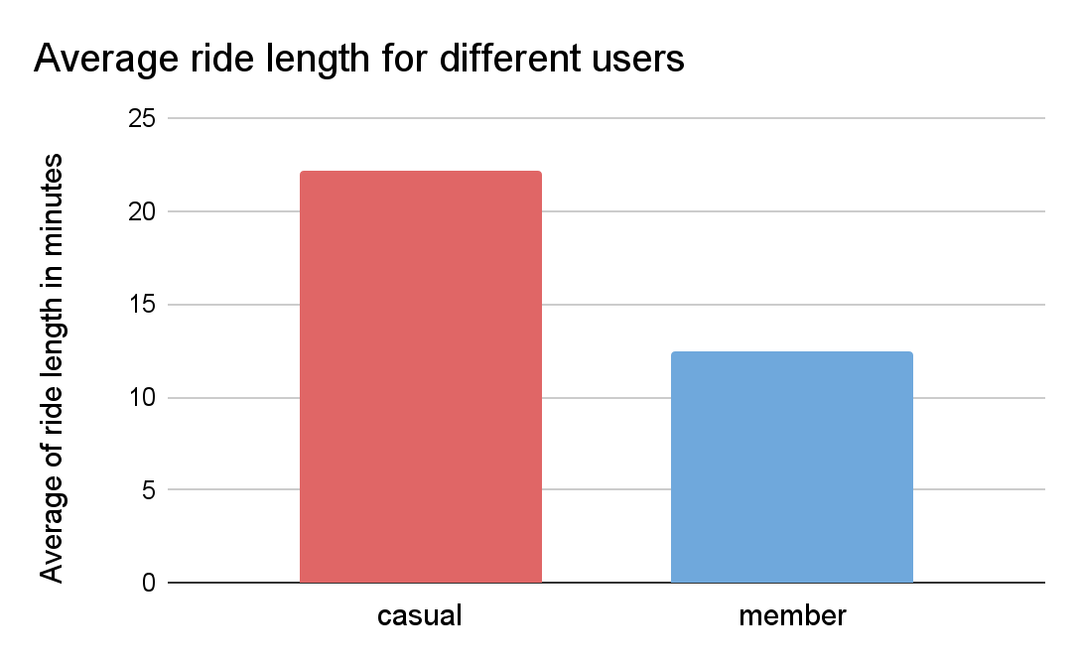
Ride duration for different users
Casual users use bike for long duration (almost double) than the membership riders.
Membership users use bikes for shorter duration of rides averagely around 12.5 minutes per ride.

Slide 10
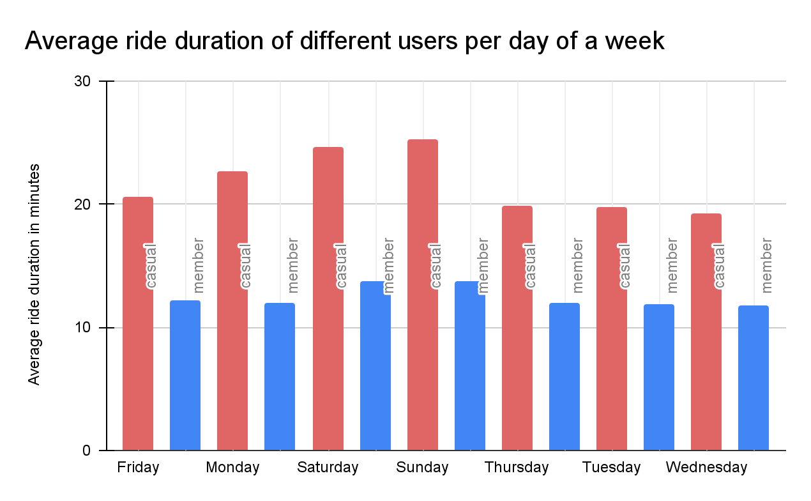
Ride duration on weekly basis
Casual users use bike for longer duration irrespective of day of a week.

Slide 11
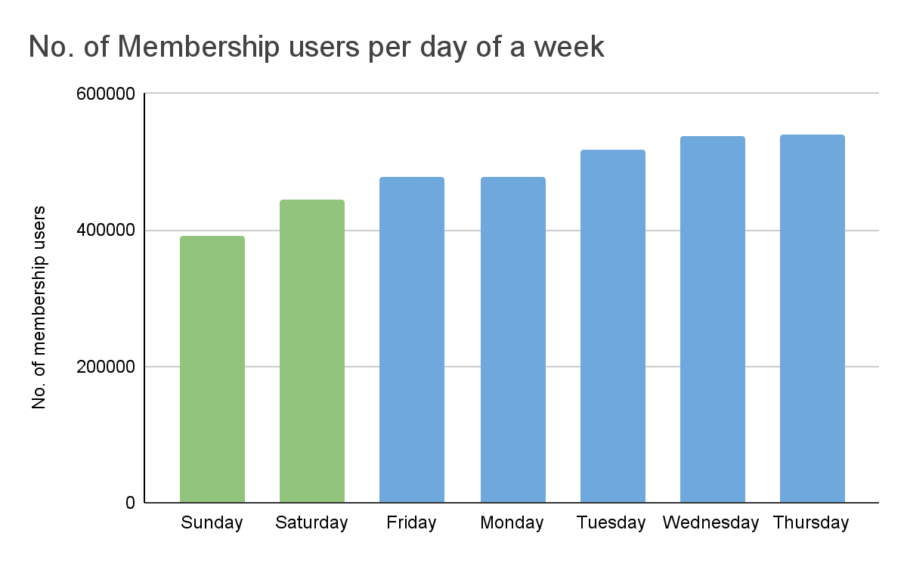
Membership users frequency on weekly basis
Membership users use bikes lowest on Sundays and next lowest is Saturdays.

Slide 12
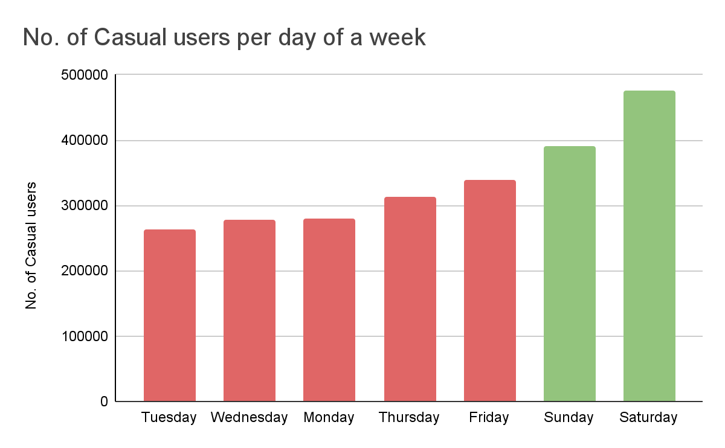
Casual users frequency on weekly basis
Casual users use the bikes highest on Saturdays and Sundays are the next.

Slide 13
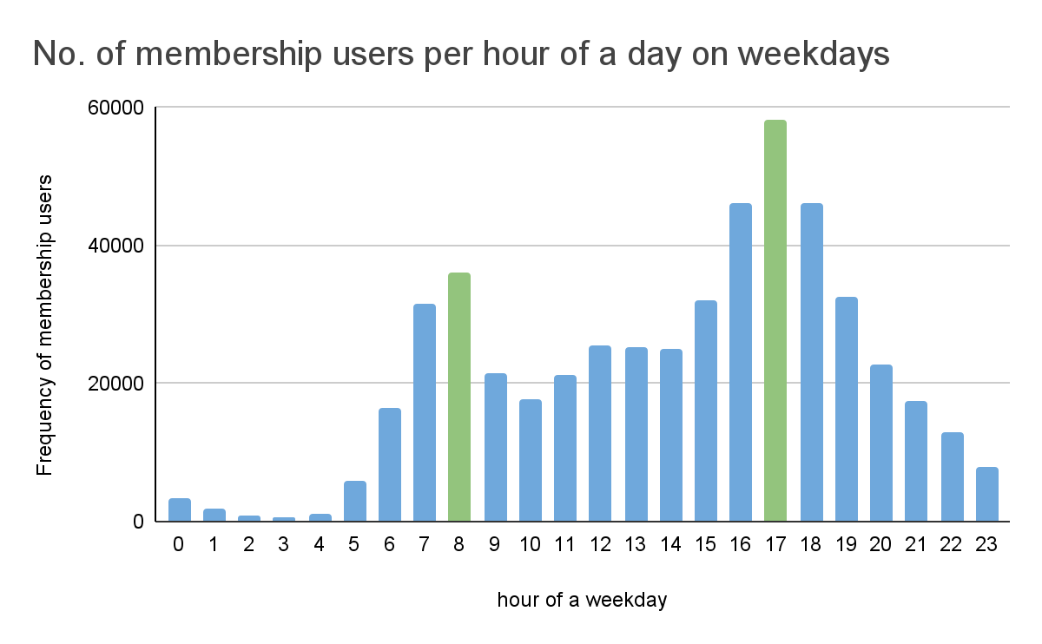
Membership users per hour on weekdays
We can clearly see that on weekdays, Members use bikes more frequently between 8am - 9am and 5pm - 6pm (highest peak).
Assumption: To compare the frequency of membership users on weekdays and weekends, we divide the frequency of membership users on weekdays by 5 and on weekends by 2.

Slide 14
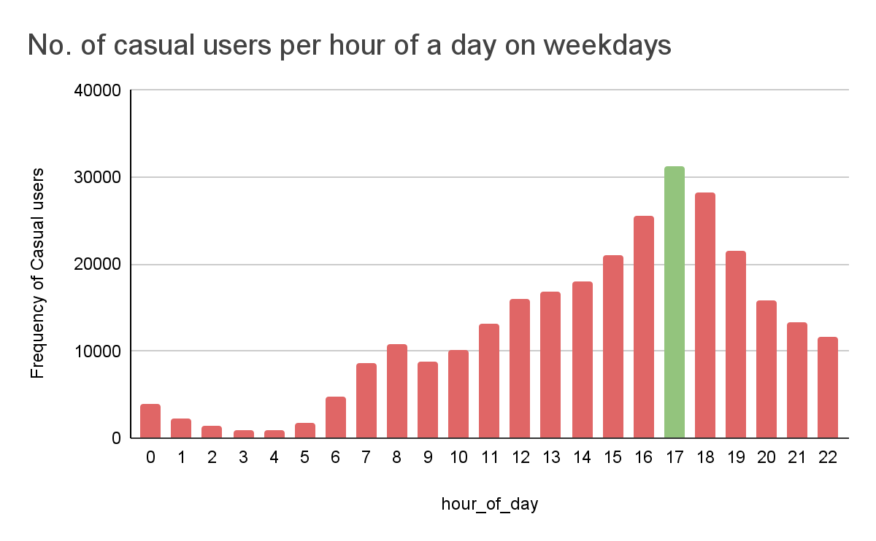
Casual users per hour of a day on weekdays
We can see that on weekdays, casual users use bikes most on 5 pm - 6 pm and there is a very small spike at 8am - 9am.

Slide 15
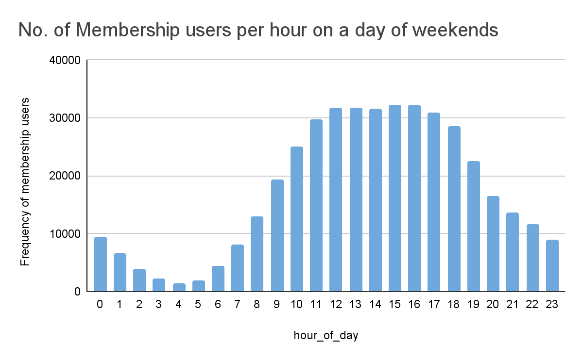
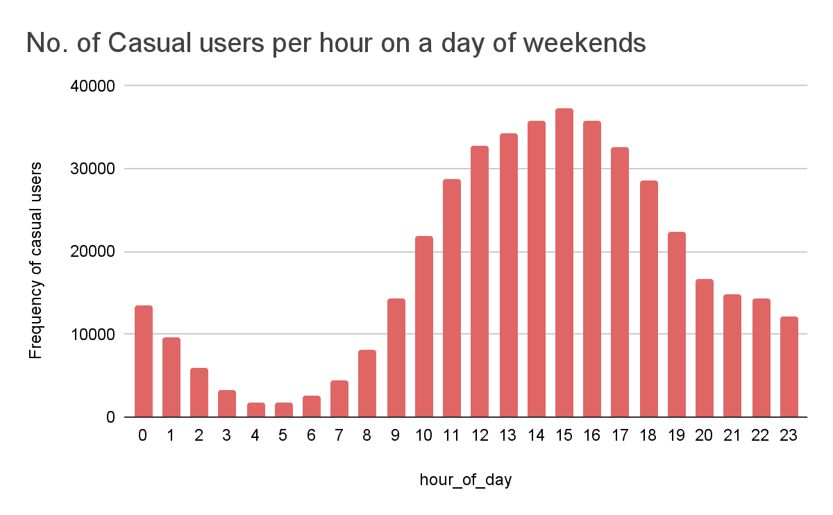
Frequency of users per hour of a weekend comparison
We can see that Members and casual users follow a similar trend in frequency of bikes usage on weekends.
There isn’t any spike in bike usage by either of the users at 8am - 9am.
Both users use bike predominantly between 11 am - 6 pm on weekends.

Slide 16
Conclusions

Slide 17
Conclusions:
Casual users are longer durational riders who use bikes more frequently on weekends and 5-6pm of weekdays.
Membership users are short durational bike users who use bikes frequently during 8-9am and 5-6 pm on weekdays and similarly to the causal users on weekends.
Majority of the membership users are employees who go to office and come back using bikes.
In the period Dec 21 - Nov 22 , Membership users aren’t interested in using Docked bikes at all whereas Casual users used them rarely.

Slide 18
Appendix

Slide 19
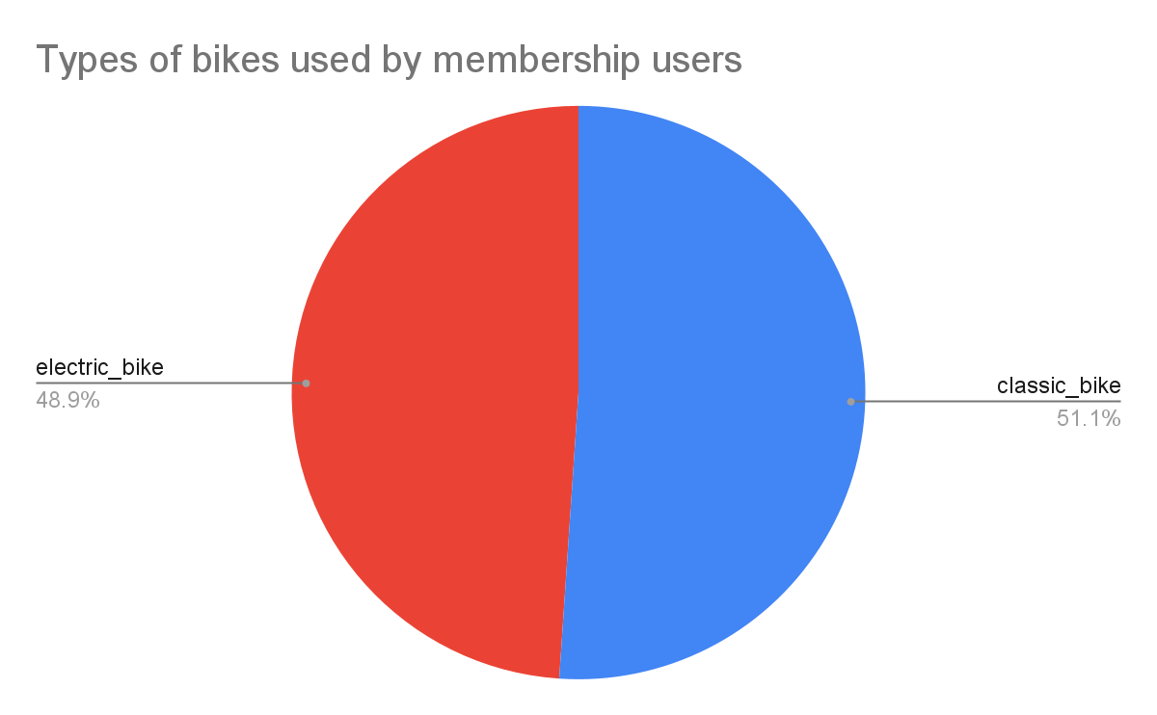
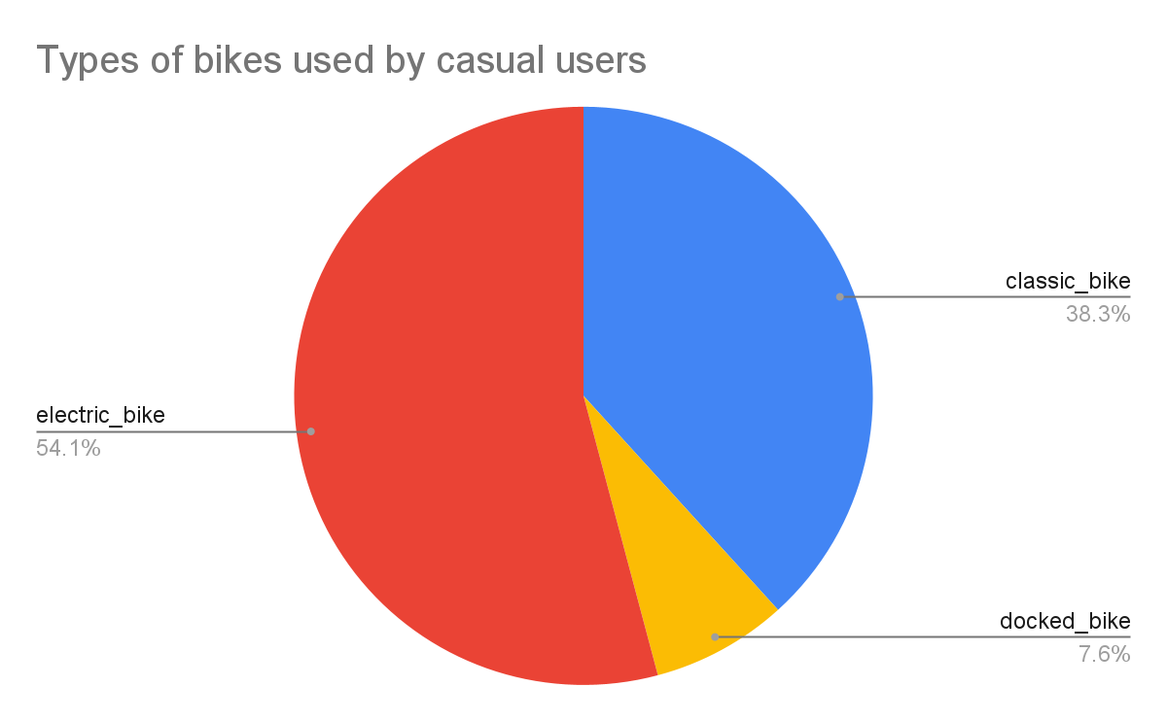
Types of bikes used by different users
In the year Dec 21 to Nov 22,
docked bikes are not used by membership users and also electric bikes and classic bikes are used almost equally.
docked bikes are only used 7.6 % and electric bikes are the most commonly used bikes by casual users.

Slide 20
Recommendations:
22.97% of the data contain missing values caused due to error in latitude, longitude columns of start station and end station which can be rectified as it can be a problem in downloading data from the source.
This missing data restricted the usage of start station name, id, lat, lon and end station name, id, lat, lon as this might lead to wrong conclusion of data.
The Docked bike usage need to be check over years to find data patterns in it.

